Slide 1
ELK Integration with ServiceNow

Slide 2

Elastic Stack Overview
Elastic Stack: Tools for managing and analyzing data.
Handles logs, system monitoring, and beyond.
Scalable, robust, widely used.
Open-source
Elastic was founded in 2012.

Slide 3
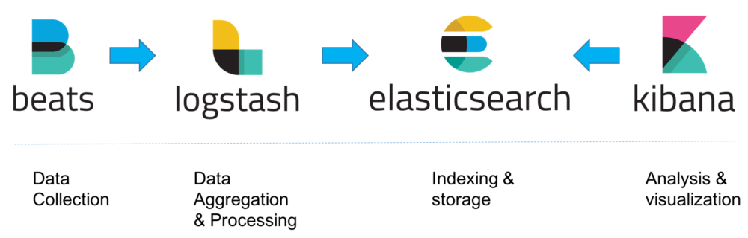
Collet logs
Parse & structure log
Search engine
Visualize log

Slide 4
What is Filebeat?
Ingests logs
Lightweight: Developed in Go
Robust: Remembers where it stopped.

Slide 5
What is Logstash ?
Parsing field of logs with filter
Sort log by format and log level with pipeline

Slide 6
What is Kibana?
Web-based Visualization Tool
Create Dashboards
Data Exploration
Configure part of elastic search
Manage our cluster

Slide 7
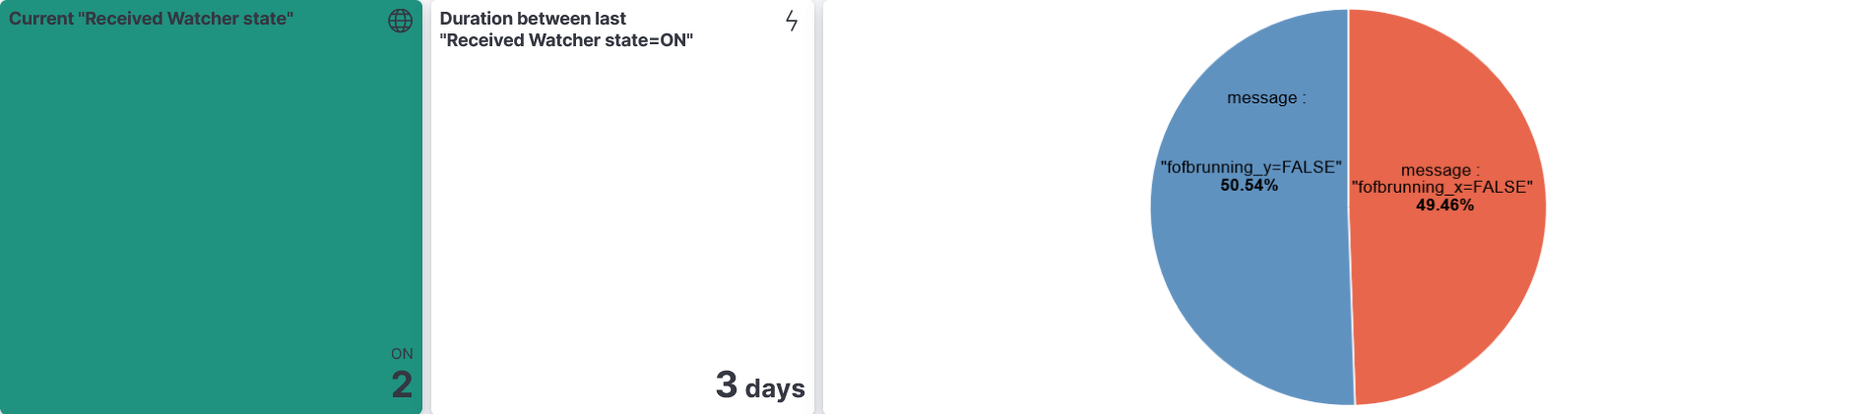
Explore & Visualize

Slide 8

ServiceNow Overview
Enterprise cloud platform for digital workflows
Single system of record for IT services
Low-code/no-code development environment
Configurable rather than customizable approach

Slide 9
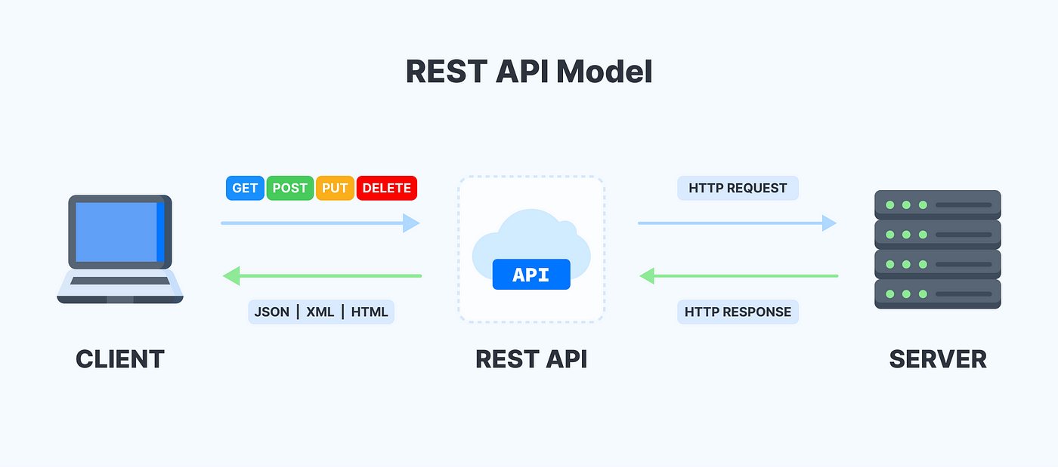
REST API Endpoints
Table API: /api/now/table/{tableName}
Aggregate API: /api/now/stats/{tableName}
Import API: /api/now/import
Attachment API: /api/now/attachment
Service Catalog API: /api/sn_sc/servicecatalog

Slide 10
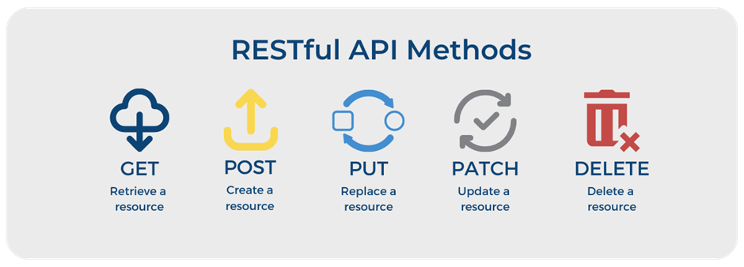
Common HTTP Methods
GET: Retrieve records
POST: Create new records
POST: Create new records
PATCH: Update specific fields
DELETE: Remove records

Slide 11

What is an SLA
Formal, documented agreement between service provider and customer
Defines expected level of service quality and performance
Sets measurable standards and metrics
Establishes accountability and expectations
Legally binding contract in most business relationships

Slide 12
Key Components of an SLA
Service Description: Specific services covered
Performance Metrics: Measurable targets
Measurement Methods: How metrics are calculated
Roles & Responsibilities: What each party handles
Issue Management: How problems are reported and resolved
Review & Revision Process: How/when the SLA is updated

Slide 13

Integrating ELK with ServiceNow
Automated incident creation from ELK-detected events
SLA breach monitoring and response
Real-time log analysis driving ServiceNow workflows
Closed-loop incident management

Slide 14
Workflow Process
System logs are collected and shipped to Logstash
Logs are parsed, transformed, and indexed in Elasticsearch
Elasticsearch detects SLA breaches via Watcher or alerts
Python script is triggered when SLA breach is detected
Script extracts relevant data and formats as JSON
Formatted data sent to ServiceNow via REST API
Incident automatically created in ServiceNow

Slide 15
SLA Breach Detection
Elasticsearch Watcher for threshold-based alerting
Configurable alert conditions:
Response time thresholds
Error frequency
Availability metrics
Custom business SLAs
Alert actions trigger Python script execution

Slide 16
Benefits & Business Value
Reduced Mean Time to Detection (MTTD)
Accelerated incident response times
Decreased manual ticket creation
Improved SLA compliance
Enhanced correlation between logs and incidents
Better visibility into service health
Historical analysis of incident patterns

